Slide 1
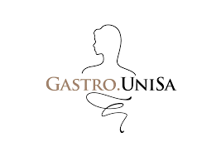
OVERGROWTH BATTERICO: DIAGNOSI E TRATTAMENTO
Dott.ssa Antonella Santonicola
Gastroenterologia
Dipartimento di Medicina, Chirurgia e Odontoiatria
Università degli Studi di Salerno

Slide 2
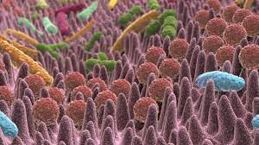
GUT MICROBIOTA
In a state of eubiosis within the gut microbiota, the human body relies on a diverse array of host defense mechanisms:
Gastric acid secretion
Intestinal motility
Intestinal anatomic integrity
Innate and adaptive immunity (i.e. IgA)
Pancreatobiliary secretions
The deregulation of any of these protective mechanisms can lead to microbiota dysbiosis, a potential pathway for the development of Small Intestinal Bacterial Overgrowth (SIBO)
Ginnebaugh, et al. Gastroenterol. Clin. N. Am. 2020

Slide 3
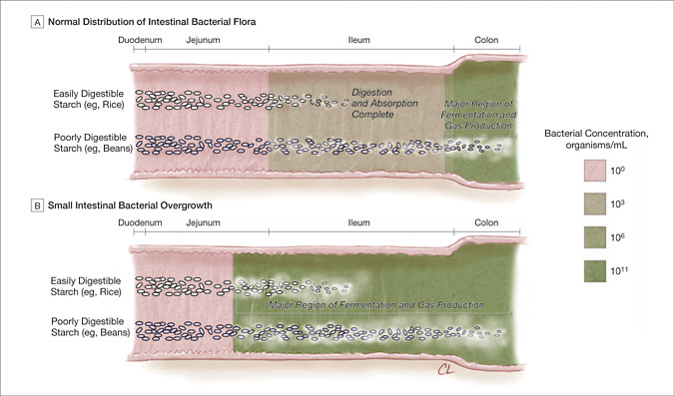
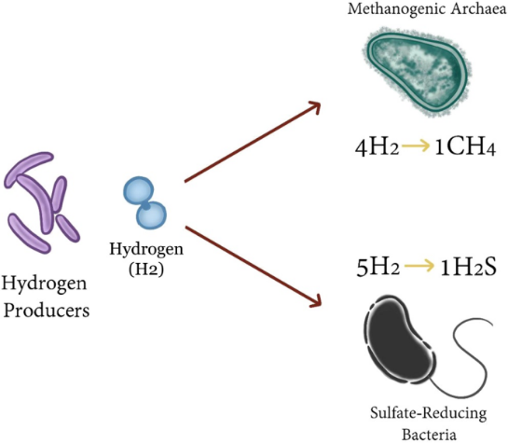
SIBO
SIBO is characterized by increased colonization of anaerobic and aerobic microorganisms within the small intestine, predominantly Gram-negative
Lin et al. JAMA 2004
Skrzydło-Radomańska et al. J Clin Med. 2022

Slide 4
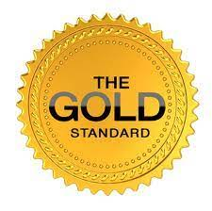
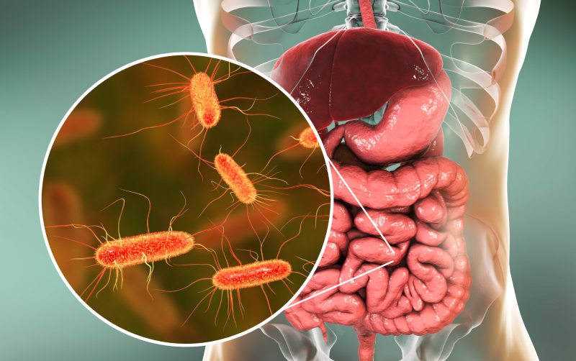
SIBO DIAGNOSIS
Small Intestinal Fluid Aspiration for Quantitative Culture
standard EGD
enteroscopy
3 to 5 mL of fluid aspirated.
sample placed into a sterile container and immediately transported to the microbiology laboratory to undergo quantitative culture.
significant risk of contamination
sampling error
sample mishandling
Alternatively, to traditional culture-based methods, microbial identification can be achieved via genetic 16S ribosomal RNA PCR-based analysis
Ginnebaugh, et al. Gastroenterol. Clin. N. Am. 2020
Skrzydło-Radomańska et al. J Clin Med. 2022

Slide 5
SIBO DIAGNOSIS
Breath Testing
glucose breath test (GBT)
lactulose breath test (LBT)
Noninvasive, accessible, cost-effective
Limited sensitivity and specificity
The diagnostic concordance between small intestinal aspirate culture and routinely used breath testing is approximately 65%
Skrzydło-Radomańska et al. J Clin Med. 2022
Mattio et al. Neurogastroenterology & Motility. 2024

Slide 6
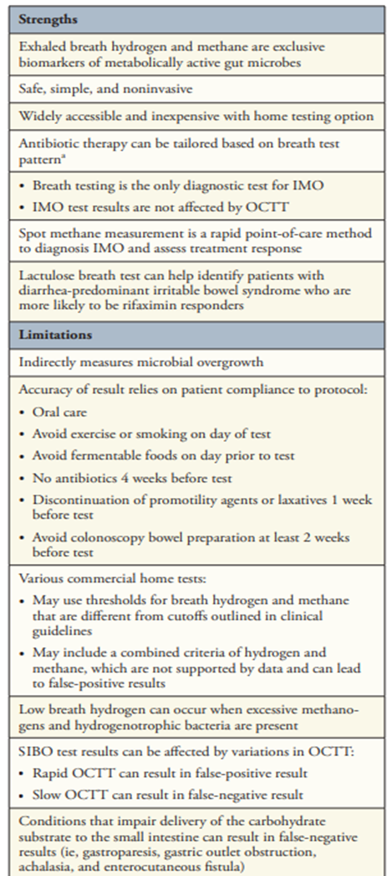
Gastroenterology & Hepatology 2023

Slide 7
All subjects underwent a glucose breath test, blood sample, physical examination with anthropometric data, digestive anamnesis, food survey, and fecalogram.
All patients underwent a Lanroth-type RYGB: a biliary limb length of 40 cm, an alimentary limb length of 150 cm, and the length of the common channel depending on the total length of the small intestine
These explorations were performed before surgery and up to 2 years after surgery (1, 3, 6, 9, 12, 18, and 24 months).
PPI therapy
Carbohydrates in the diet
Surgical technique
High prevalence of bacterial overgrowth before and immediately after RYGB, affecting 89.5% of the patients.
Positive correlation between exhaled hydrogen and lipid malabsorption.
Lipid excretion was positively correlated with the hydrogen concentration in expired air
An increase of 5 g of lipids in the stool increased by 5% the concentration of hydrogen.
OBSU 2024

Slide 8
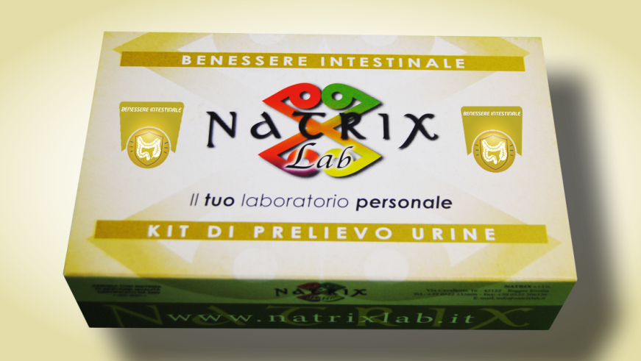
SIBO DIAGNOSIS
MYTH OR FUTURE?
Intestinal dysbiosis by urine samples
NO EBM
5

Slide 9
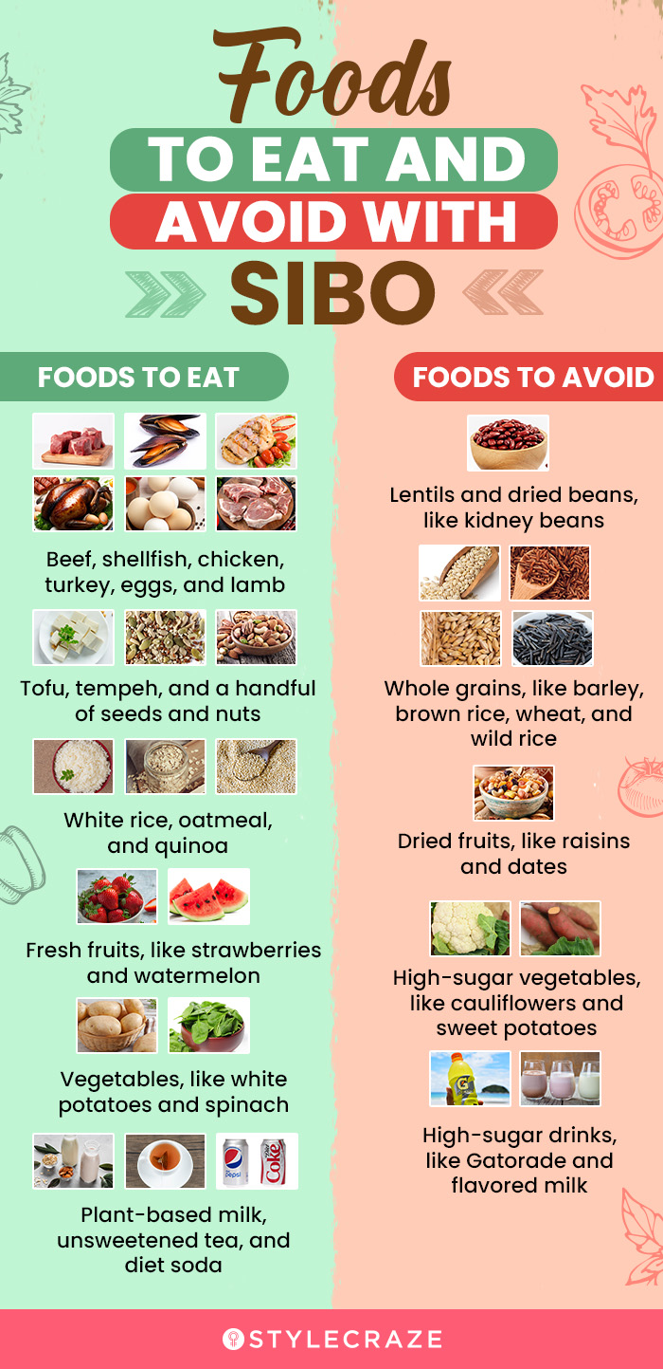
SIBO TREATMENT
DIET
Published data regarding dietary therapy for SIBO are scarce and largely extrapolated from studies in patients with IBS
A diet low FODMAP diet deprives bacteria of their source of energy necessary for proliferation and reduces bacterial fermentation, as evidenced by low levels of hydrogen in breath tests.
The period of complete elimination of FODMAP from the diet of SIBO patients should not exceed six weeks.
There is no evidence supporting the use of a gluten-free diet in the treatment of SIBO.
The use of elemental diets, which contain pre-digested nutrients, is not recommended in SIBO despite some promising study reports.
Dionne et al. Am. J. Gastroenterol. 2018
McIntosh et al. Gut 2017

Slide 10
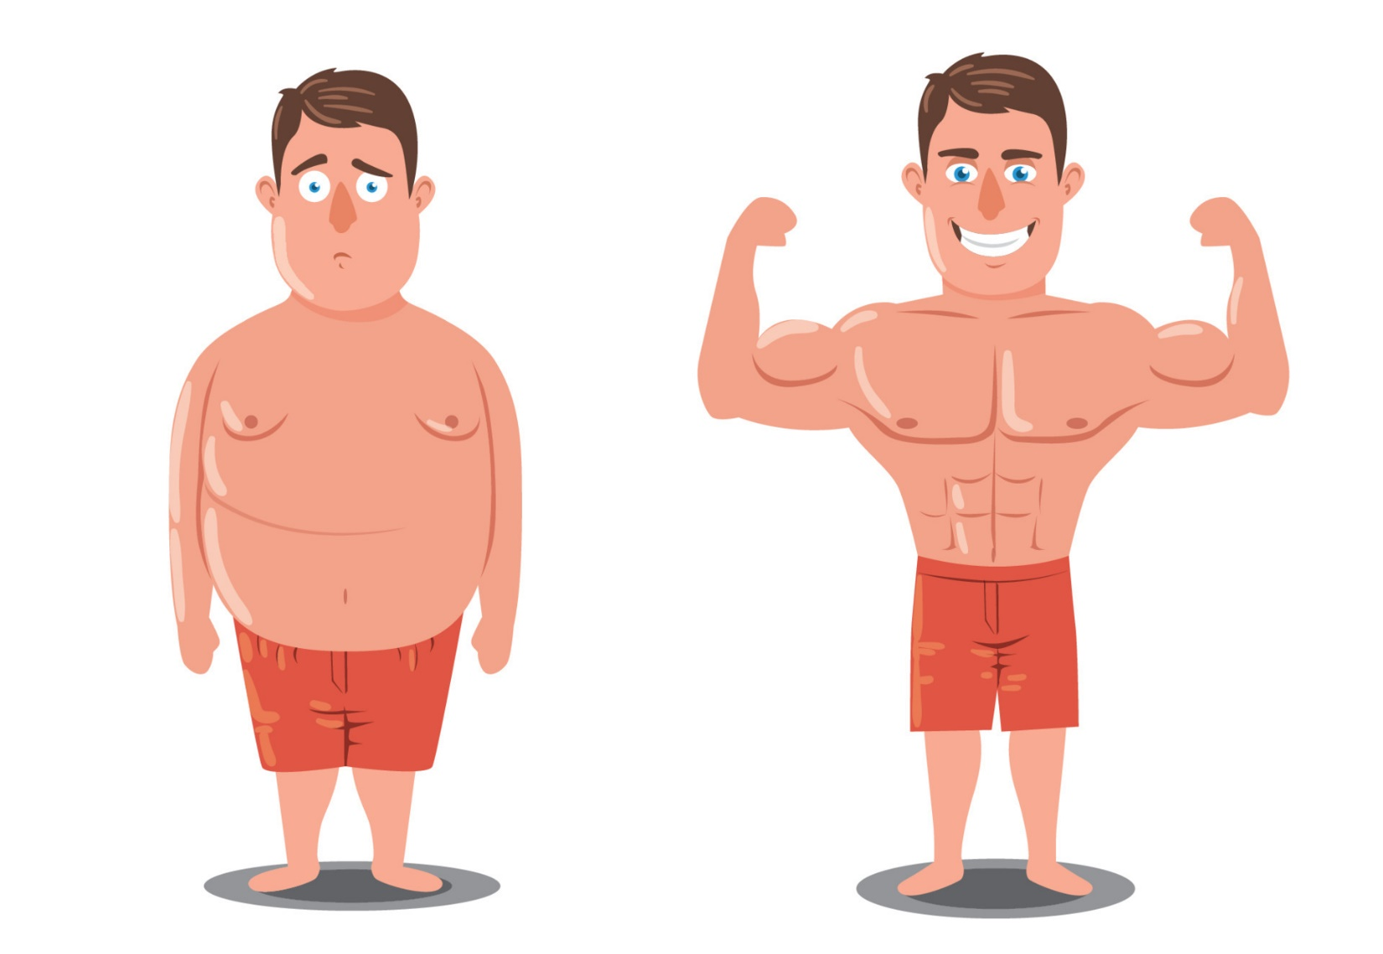
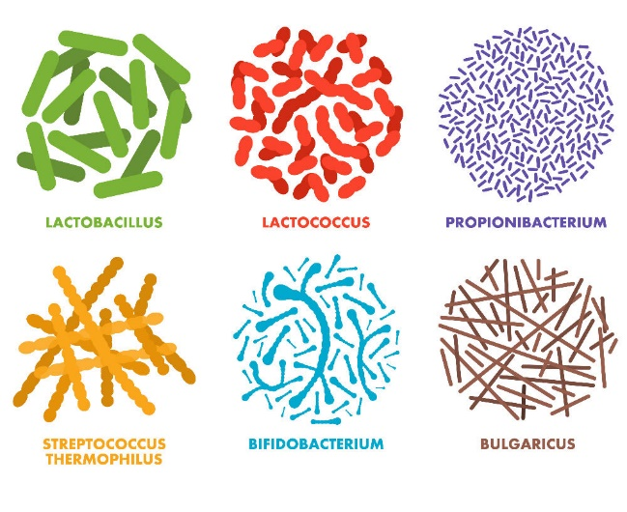
SIBO TREATMENT
PROBIOTICS
=
?
Probiotics modulate the composition of intestinal microbiota and protect the gut against colonization by pathogens.
Probiotics are a source of a number of substances that limit the growth and metabolism of microorganisms
Probiotics compete with other bacteria for nutrients and adhere to the gut epithelium
Probiotic therapy was associated with a slightly decreased incidence of SIBO, although this preventive effect was not statistically significant.
Patients with SIBO using probiotics had a significantly higher SIBO decontamination rate compared with the nonprobiotic users
Zhong et al. J Clin Gastroenterol 2017

Slide 11
55 RYGB patients
Probiotic group n=36; Control group n=39
Probiotic 50B® (Pure Encapsulations, Nestlé Health Science, Hoboken, NJ, USA) composed of 50 billion CFU per capsule (Lactobacillus acidophilus La-14, Bifdobacterium lactis Bl-04, Lactobacillus rhamnosus GG, Bifdobacterium longum Bl-05, Lactobacillus plantarum Lp-115, Bifdobacterium bifdum Bb-06, Lactobacillus gasseri Lg-36)
GSRS questionnaire for GI symptoms evaluation
Hydrogen breath test with 25 g of glucose for SIBO assessment
OBSU 2024

Slide 12
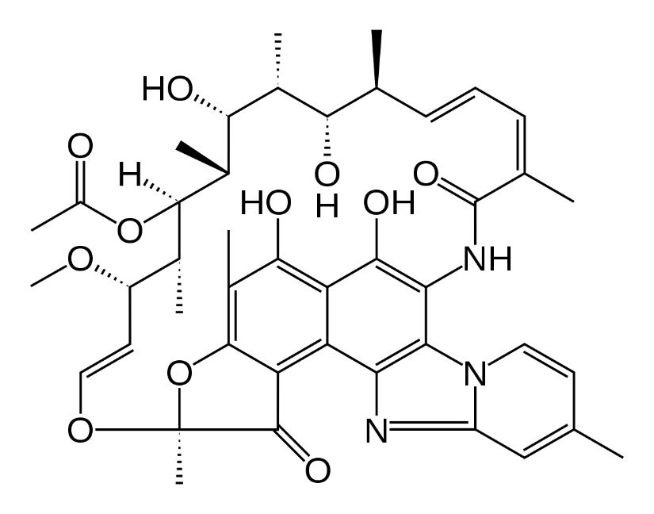
SIBO TREATMENT
ANTIBIOTIC THERAPY
lack of large randomized clinical trials evaluating the effects of antibiotics in the treatment of SIBO
limited data comparing the efficacy of different antibiotics
Rifaximin is the antibiotic of choice
- good safety profile,
placebo-like adverse event rates,
low rate of resistance
broad-spectrum antibacterial effects against Gram-positive and Gram-negative aerobic and anaerobic bacteria
eubiotic effect through increasing beneficial bacterial strains
Overall eradication rate of rifaximin for SIBO is 70%;
Efficacy of rifaximin in treating SIBO is dose-dependent, with 1600 mg/day for 1 week having the highest eradication rate;
Aliment. Pharmacol. Ther. 2017

Slide 13
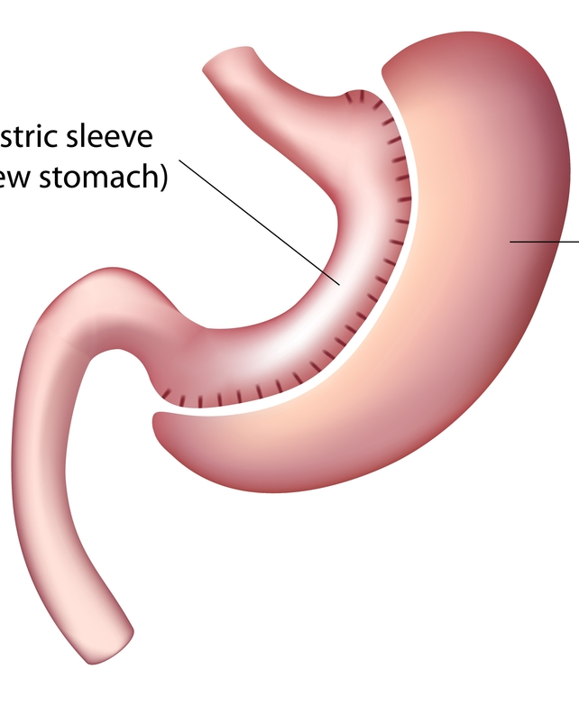
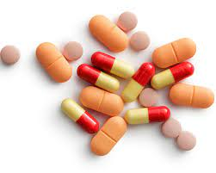
Sleeve gastrectomy
Antibiotic therapy has been shown to effectively treat and
improve digestive symptoms in bariatric patients diagnosed
with SIBO after surgery
Up to this date, there is no consensus on the choice, dosage, and duration of antibiotic therapy for SIBO; therefore, different therapies have been tested.

Slide 14
SIBO TREATMENT
PROKINETICS & HERBAL THERAPY
American Journal of Gastroenterology 2001
N Engl J Med 1991;
Although the results showed no significant differences in the normalization of exhaled gas curves between groups, the patients treated with herbal supplements and probiotics showed an improved response in gastrointestinal symptoms,
Nutrients 2024

Slide 15
CONCLUSIONS
On many levels, SIBO remains an enigma.
Data about SIBO after BS are scattered in the literature and mainly focused on RYGB.
There is limited information about the role of SIBO in the increase in digestive symptoms, yet SIBO by itself might be a contributing factor, increasing vitamin deficiencies and affecting weight loss after BS.
The main challenge is the lack of a scientifically validated diagnostic gold standard.
Though there are many treatment options, few can claim being truly evidence-based.
Thus, when confronted with a patient in whom SIBO is a concern, a provider is faced with a difficult choice: ordering an imperfect test or empirically recommending a course of treatment that offers marginal efficacy.

Slide 16
THANKS

